Slide 1
Who Are You? Sara Billingsley
Notes:
Introduction slide: Creative title, your name, graphic

Slide 2
ROUTINE TRAVELS
Notes:
Body #! title slide: Title of first main idea, graphic

Slide 3
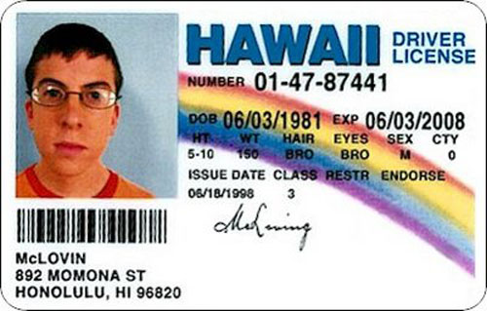
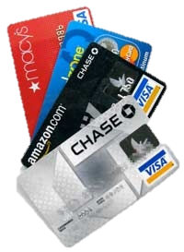
Notes:
Body #1 supporting slide

Slide 4
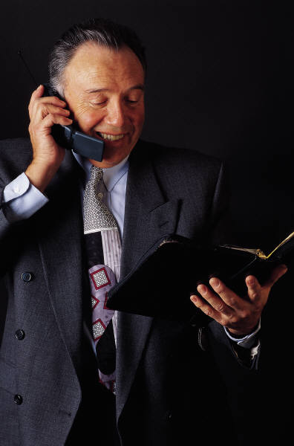
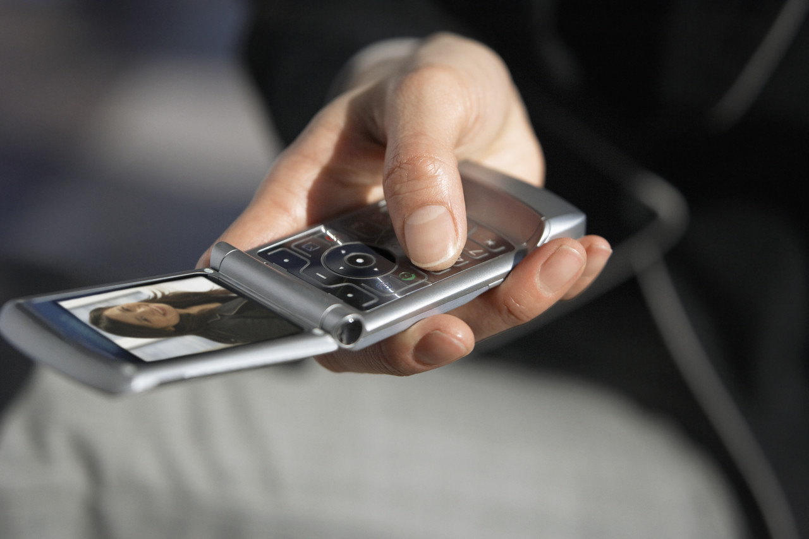
Notes:
Body #1 supporting slide

Slide 5
SOCIAL NETWORKS
Notes:
Body #2 title slide: title of main idea, graphic

Slide 6
Notes:
Body #2 supporting slide

Slide 7
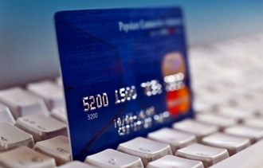
ONLINE TRANSACTIONS
Notes:
Body #3 title slide: Title of main idea, graphic

Slide 8
Notes:
Body #3 supporting slide

Slide 9
Notes:
Conclusion slide: graphic only

