Slide 1
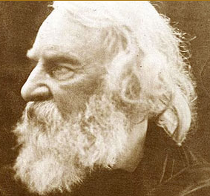
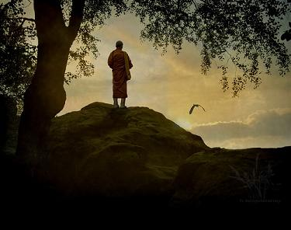
A Psalm of Life What the Heart of the Young Man Said to the Psalmist
By Henry Wadsworth Longfellow

Slide 2
The Title of the Poem
The word “psalm” in the title makes me think that the poem will be religious in nature. There is a book in the Bible called Psalms, many of which focus on the brevity of life. (e.g., Psalm 39:5, Psalm 90:12)
The synecdoche in the subtitle (“heart”) indicates the emotional aspect of the poem.
Back to Title Slide

Slide 3
Metrical feet or lines; verses
Rhyme scheme
Tell me not in mournful numbers, Life is but an empty dream! For the soul is dead that slumbers, And things are not what they seem.
A
B
A
B
The use of masculine rhyme in lines 2 & 4 places emphasis on “dream” and “seem.” This suggests the main idea of the stanza—reality versus illusion. What is our real purpose? We are not here only to live out our lifespan and then die meaninglessly.
Feminine rhyme: lines 1 & 3; “numbers” and “slumbers”
Masculine rhyme: lines 2 & 4; “dream” and “seem”
NEXT STANZA

Slide 4
NEXT STANZA
Previous Slide
Longfellow uses a “sleep” metaphor in the first stanza. He starts out by saying that life is not an “empty dream.” This metaphor expresses that our lives have purpose. The idea of life being a dream suggests that it is only an illusion or that it will amount to nothing. The word “empty” emphasizes the idea of futility.
He continues that metaphor in line 3 with “the soul is dead that slumbers.” If we are not realizing our life’s purpose, i.e., “slumbering,” then we are not having the impact on the world that we are meant to have.

Slide 5
Exclamation points show his “earnestness.”
Reminds me of the common lines of funeral services: “ashes to ashes; dust to dust.”
Life is real! Life is earnest! And the grave is not its goal; Dust thou are, to dust thou returnest, Was not spoken of the soul.
Once again, the masculine rhyme in lines 2 and 4 of this stanza, emphasizes “goal” and “soul.” This contributes to the serious and religious tone of the poem. We must set goals in your lives, and these goals must be life-affirming and enriching. The word “soul” appears again, reiterating the spiritual nature of man.
Only the physical body will return to dust. The soul is everlasting. The soul is our true being, while the body is only the vessel that holds our soul.

Slide 6
Not enjoyment, and not sorrow,
Is our destined end or way;
But to act, that each to-morrow
Finds us farther than to-day.
“destined”: We were made with a purpose. We have been “destined” to live meaningfully.
Life is not about emotions (“enjoyment” or “sorrow”); rather, it is about action—what we do with our lives is what really counts.

Slide 7
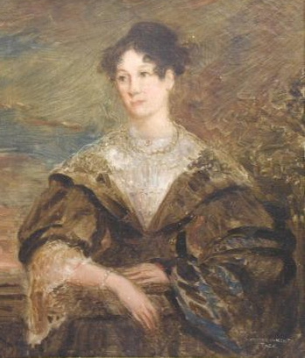
Lasts a long time (after we’re long gone)
We don’t have long on this earth.
Stout = strong
Art is long, and Time is fleeting,
And our hearts, though stout and brave, Still, like muffled drums, are beating Funeral marches to the grave.
Simile: “like muffled drums” – The sound of drums suggest the beating of a heart, but the drums are “beating funeral marches,” i.e., we will all die.
Longfellow wrote this poem after his first wife’s death after a miscarriage. He was extremely depressed after her death. Later, he pursued and was rejected by Fanny Appleton, which also lead to some depression.

Slide 8
Bivouac: a temporary encampment of troops; this metaphor again suggests the brevity of life
In the world's broad field of battle,
In the bivouac of Life,
Be not like dumb, driven cattle!
Be a hero in the strife!
Lots of alliteration in this stanza:
Broad dumb
Battle driven
Bivouac
Be
be
These alliterations imitate the sounds of bombs dropping, appropriate for the battlefield metaphor.
Next Stanza

Slide 9
Metaphor
The battle metaphor suggests the struggles and conflicts of the world. Longfellow experienced some personal struggles right around the time of his writing this poem. Examples of conflicts during this time in America are slavery, economic struggles related to industrialism, and the fight for women’s rights.
Previous Slide

Slide 10
Metaphor
The cattle metaphor states that we are not just dumb animals. We have minds and souls. We should not just go wherever outside forces “drive” us; rather, we should live with purpose.
Previous Slide

Slide 11
Makes me think of the saying, “Don’t count your chickens before they hatch.” We sometimes think that everything’s going to turn out okay in the end, but the speaker is saying not to place our trust in what might happen. We must seize the day: Act in the present! This reminds me of Ben Franklin’s aphorism: One today is worth two tomorrows.
Trust no Future, howe'er pleasant!
Let the dead Past bury its dead!
Act,--act in the living Present!
Heart within, and God o'erhead!
I noticed the contrast of the living Present and the dead Past.
Connects again with the religious tone of the poem; it’s a Psalm of life. We are accountable to God for what we do with our lives. He’s watching us.
Romantic Ideals:
Intuition and Individualism
Personification of the Past: the past should bury its dead, meaning we should not let the past hinder us in the present. We need to leave the past behind us: the mistakes and pain.

Slide 12
Lives of great men all remind us
We can make our lives sublime,
And, departing, leave behind us
Footprints on the sands of time;
Heavenly
Who are some of these “great men”? Who are our inspirations in life and what makes them great?
The use of the same word for the rhyme in lines 1 & 3 in this stanza suggests the universal meaning of the poem—the lesson is for all of US, not just the speaker of the poem.
Next Stanza

Slide 13
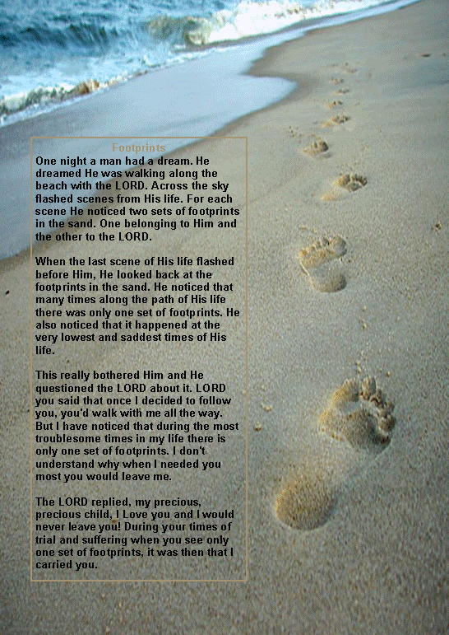
This line reminded me of the poem “Footprints in the Sand,” even though technically they aren’t saying the same thing.
Longfellow’s poem is talking about the mark we make on the world, while in the poem, the footprints belong to God who carries us through life’s difficult times.
When I think of the footprints in the sand, I also think about how they are easily washed away. Is our mark on the world that superficial?
Previous Slide

Slide 14
Footprints, that perhaps another,
Sailing o'er life's solemn main,
A forlorn and shipwrecked brother,
Seeing, shall take heart again.
Here, Longfellow uses the extended metaphor of the ship on the ocean: The person’s journey is characterized as “sailing,” and his journey is on the “main,” or the open ocean. Also, the person is “shipwrecked,” indicating that are facing a great struggle, which threatens to destroy him.
The lives we live can be an inspiration to others.

Slide 15
The poem advocates action, regardless of what the result may be. This is reminiscent of an excerpt from Ben Franklin’s “The Way of Wealth” from about a century prior.
Let us, then, be up and doing,
With a heart for any fate;
Still achieving, still pursuing
Learn to labor and to wait.
One contrast between Longfellow’s poem and Franklin’s excerpt, according to Peck, is the lack of purpose in Longfellow’s admonition. He says to “be up and doing,” but he never says what we are to be doing. In Franklin’s day the Puritan values were still dominant, and the reward for hard work was evident: success and wealth. However, by Longfellow’s day, industrialization made work much more repetitive and less rewarding. No reward is promised in Longfellow’s poem. We are to labor and wait. In a way, Peck sees Longfellow as glossing over the working conditions of factory workers. “Just keep working,” he seems to say, “for the sake of working.”

Slide 16
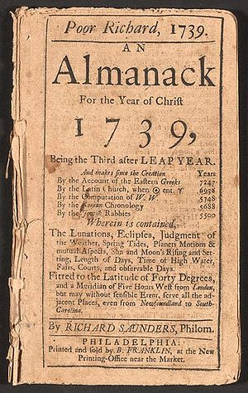
If time be of all things the most precious, wasting time must be, as Poor Richard says, the greatest prodigality, since, as he elsewhere tells us, lost time is never found again, and what we call time-enough, always proves little enough: let us then be up and be doing, and doing to the purpose; so by diligence shall we do more with less perplexity. Sloth makes all things difficult, but industry all easy.
Previous Slide

Slide 17
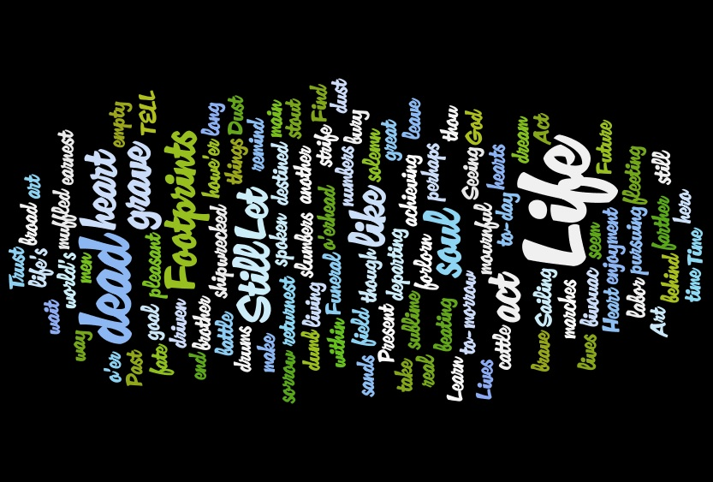

Slide 18
Works Cited
Peck, David R. "'Let us, then, be up and doing'. (Essays)." ANQ 16.3 (2003): 30+. General OneFile. Web. 8 Mar. 2012.

